Slide 1
Sorting a Plentitude of Numbers through Parallel Processing
Optimal Circuits
Gargi Bhise | Siddharth Kekre
CS 5350
Spring 2022

Slide 2
TABLE OF CONTENTS
01
02
03
04
Why Sort Data ?
Breif Introduction to Importance of Sorting
Introduction to Sorting Algorithms
Intro to Merge Sort and Quick Sort and Approach to Parallelization
Sequential v/s Parallel Sorting
Performance Analysis of Sequential & Parallel Merge Sort and Quick Sort
Summary
Summary of Experimental Findings
References
05

Slide 3
01
Why Sort Data ?

Slide 4
We have a lot of data !
There were 5 Exabytes of Information created between the Dawn of Civilization through 2003, but that much Information is now created every 2 Days.
- Eric Schmidt
(Former Executive Chairman, Google)

Slide 5
Need to Sort the Data
Make Sense of Data
with Ease
Perform Analysis
In Efficient Manner
> Lots of Data = Possibility of Lots of Information
> Sorted Data = More Time to Focus on What to do with it

Slide 6
02
Introduction to Sorting Algorithms

Slide 7
01
Merge Sort
Source

Slide 8
What is Merge Sort ?
> Merge sort is a comparison-based sorting algorithm where we divide the array into two smaller subarrays of equal size or with a size difference of one, depending on the parity of the array’s length.
> Each subarray is further divided into two smaller subarrays again and again recursively until we get subarrays of size one.
> We then sort the subarrays and merge them to produce the sorted array.

Slide 9
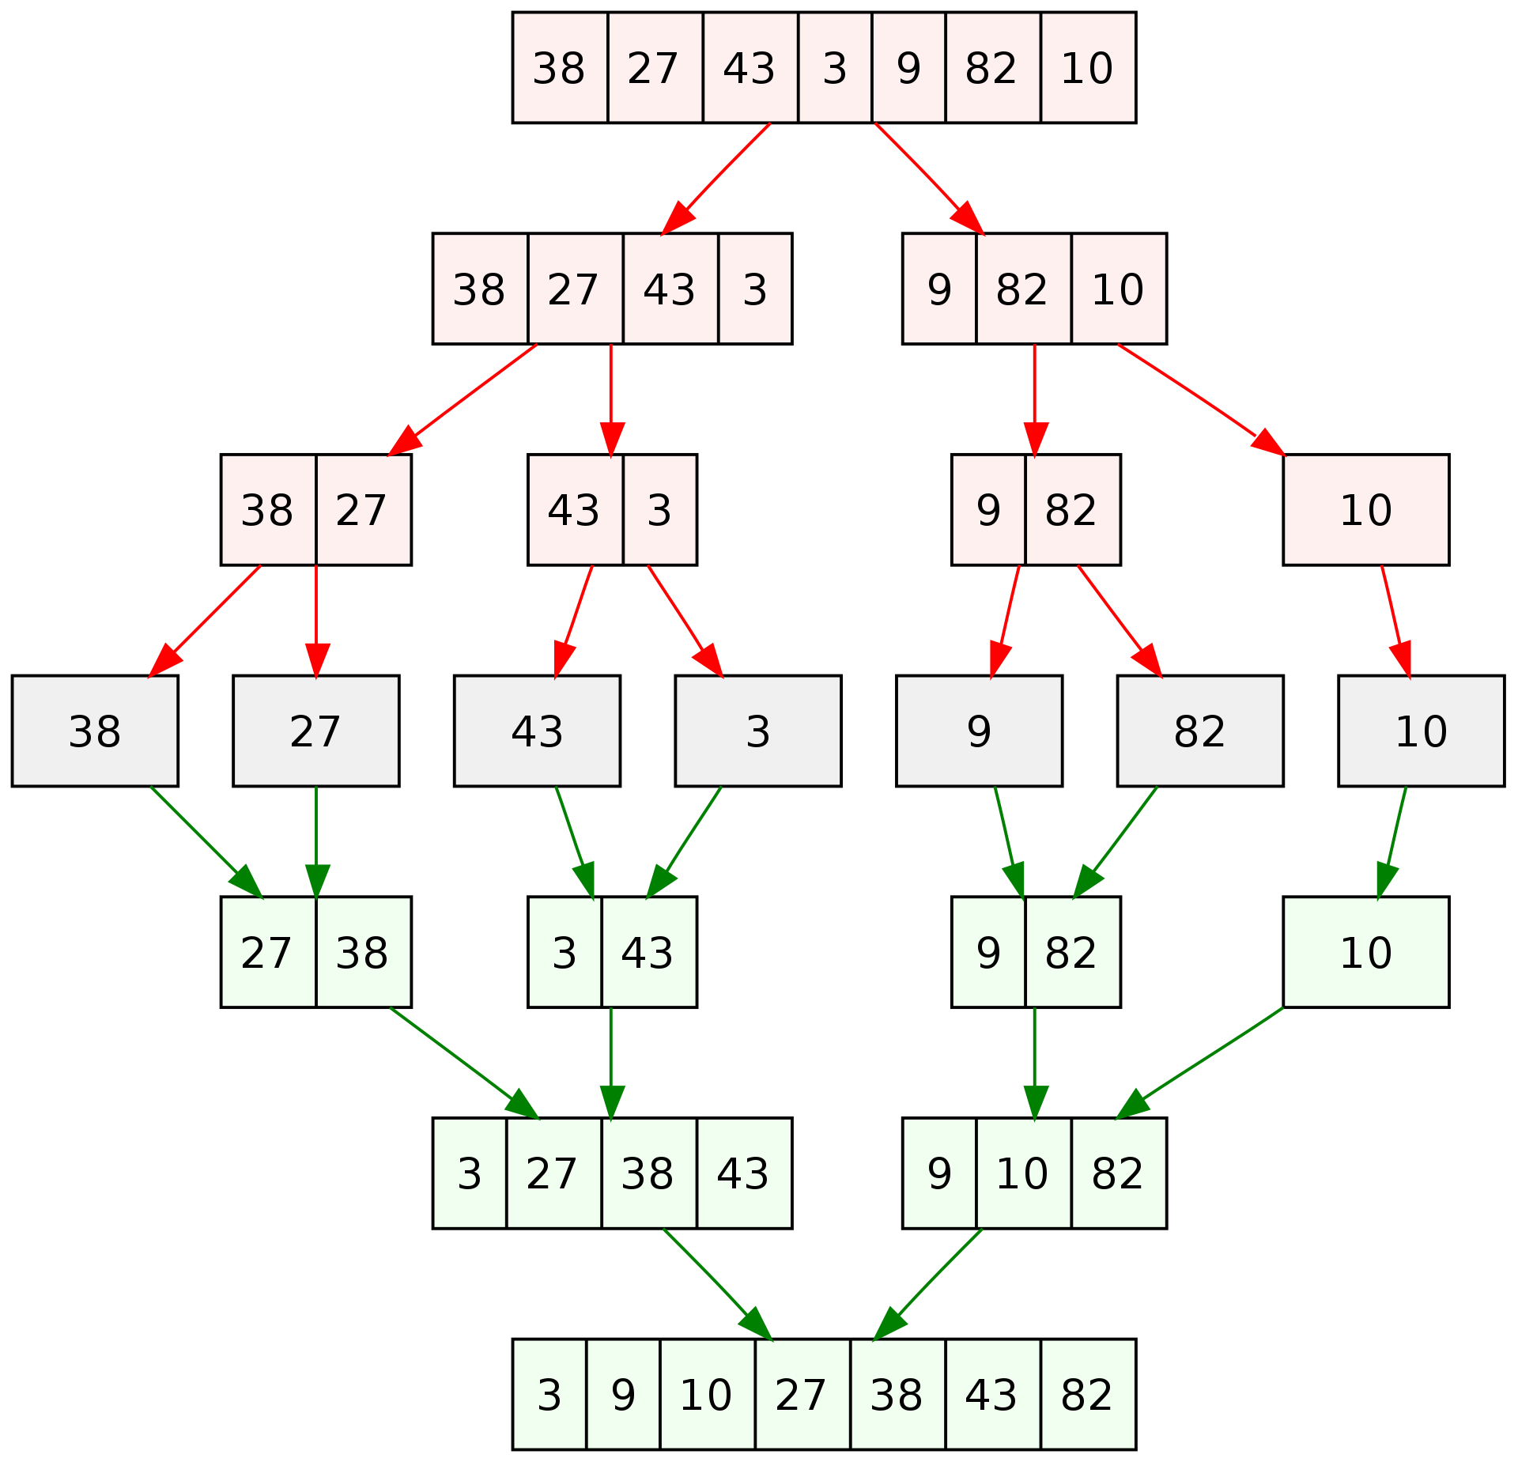
Understanding through Example
Source

Slide 10
What is Time and Space Complexity ?
> Time Complexity is an approximation of the total number of elementary operations (arithmetic/boolean instructions, memory referencing, etc.) executed throughout the program. It is assumed that each elementary operation takes a fixed amount of time (n) to perform.
> Space Complexity is the approximate total extra space/memory required by the program to run.

Slide 11
Time Completity Space Complexity
Best Case
Average Case
Worst Case
O(n log (n))
O(n log (n))
O(n log (n))
Best Case
Average Case
Worst Case
O(n)
O(n)
O(n)
Source

Slide 12
02
Quick Sort
Source

Slide 13
What is Quick Sort ?
> Quick Sort uses a divide-and-conquer strategy to divide the input array into two subarrays. We choose a random element called pivot and we then place it in its correct place and then reorder the array elements by moving all the elements less than pivot to its left and all the elements greater than it to its right.
> We then recursively sort the subarrays of these subarrays until the entire array is sorted.

Slide 14
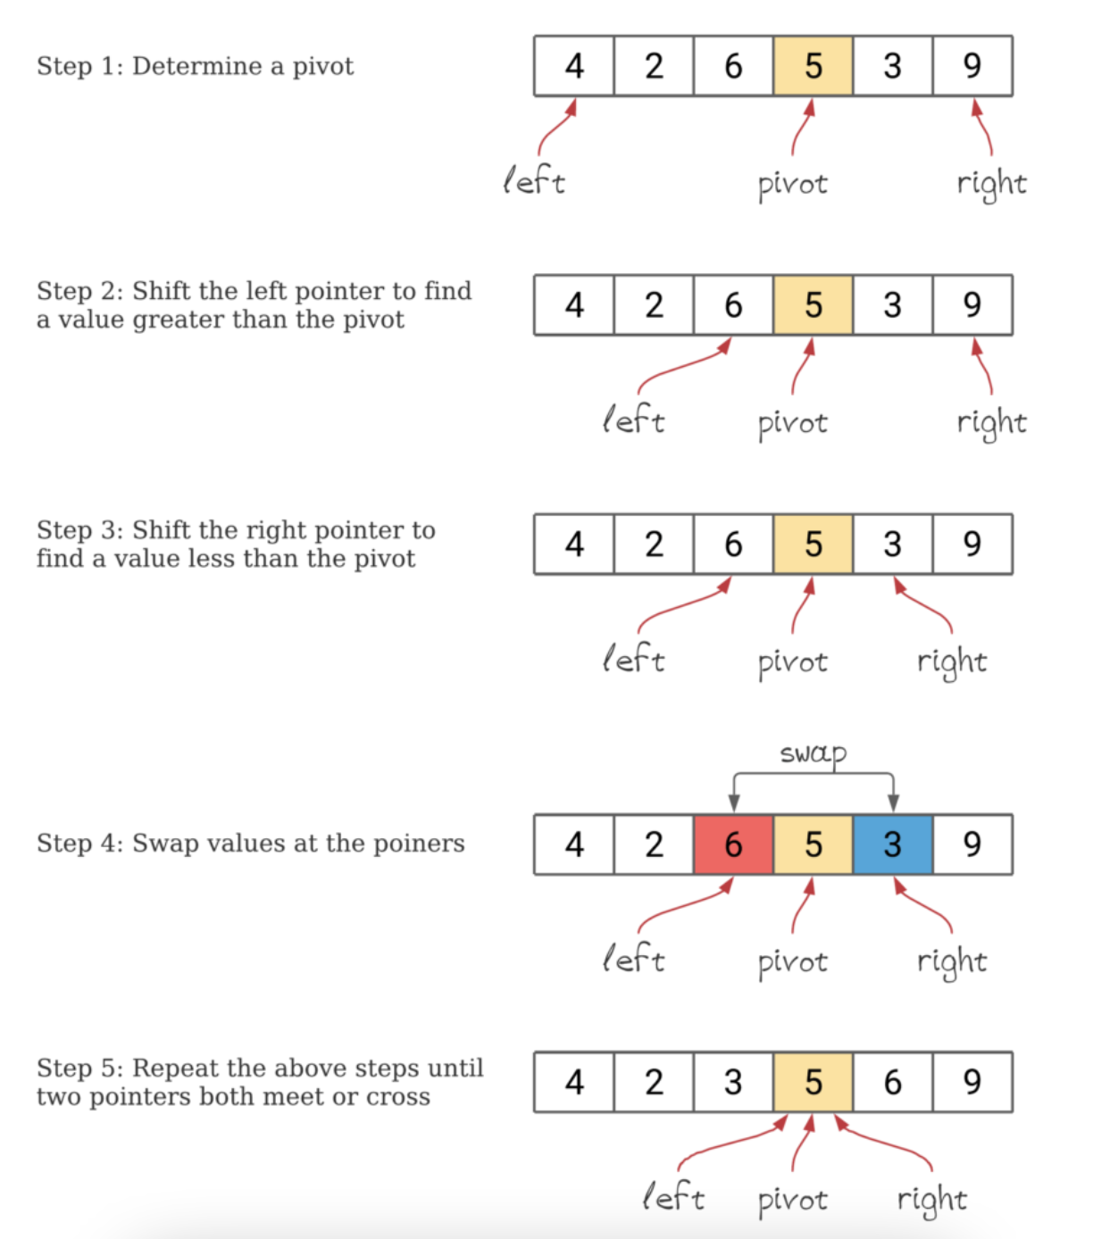
Understanding through Example
Source

Slide 15
Time Completity Space Complexity
Best Case
Average Case
Worst Case
O(n log (n))
O(n log (n))
O(n²)
Best Case
Average Case
Worst Case
O(log(n))
O(log(n))
O(n)
Source

Slide 16
03
Parallel Sorting
Source

Slide 17
Possible Approach for Parallelel Sorting
Multi-Processing
Multi-Threading
> Uses Different RAM Space for Each Job.
> Difficult to Merge Results from Sub-Tasks for Sorting Purpose.
> Uses Same RAM Space for Each Job.
> Easy to Merge Results from Sub-Tasks for Sorting Purpose.
We Implemented
Multi-Threading Approach
Source
Source

Slide 18
04
Implementing Parallel Approach in Java v/s Python
Source

Slide 19
Possible Approach for Parallelel Sorting
Java
Python
> Utilizes Fork-Join Framework.
> Unlike ThreadJoin Method, Fork-Join schedules jobs in much more efficient manner.
> Utilizes MultiProcessing Package.
> For CPU Bound Tasks, ConcurrentFeatures Package (based on MultiProcessing) provides Efficient Results.
Provided Results are obtained through
Python ConcurrentFeatures Package
Source
Source

Slide 20
03
Sequential v/s Parallel Sorting

Slide 21
01
What is Parallel Merge Sort ?
Source

Slide 22
02
What is Parallel Quick Sort ?
Source

Slide 23
Is Parallelization Faster ?
To believe without Evidence and Demonstration is an act of Ignorance and Folly.
- Socrates
(Credited as Founder of Western Philosophy)

Slide 24
03
Amdahl’s Law + Gustafson’s Law = Is Parallelization Faster ?
Source

Slide 25
04
Performance Analysis of Merge Sort

Slide 26
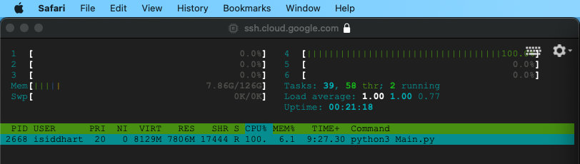
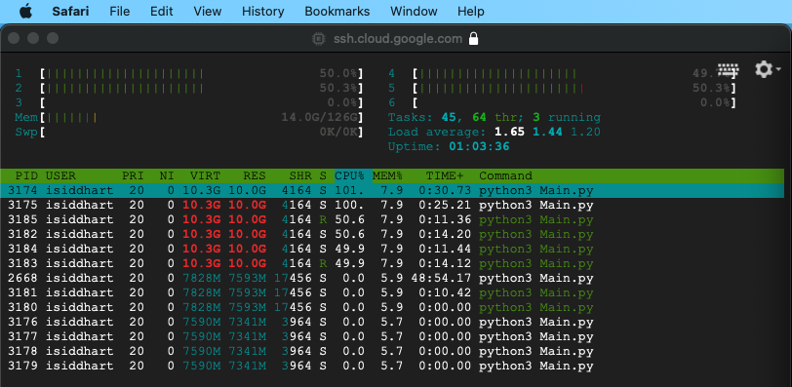
CPU and RAM Usage for Sequential Merge Sort CPU and RAM Usage for Parallel Merge Sort
Number of CPU Used : 01
Total RAM Used : 7.86 GB
Number of CPU Used : 04
Total RAM Used : 14.0 GB

Slide 27
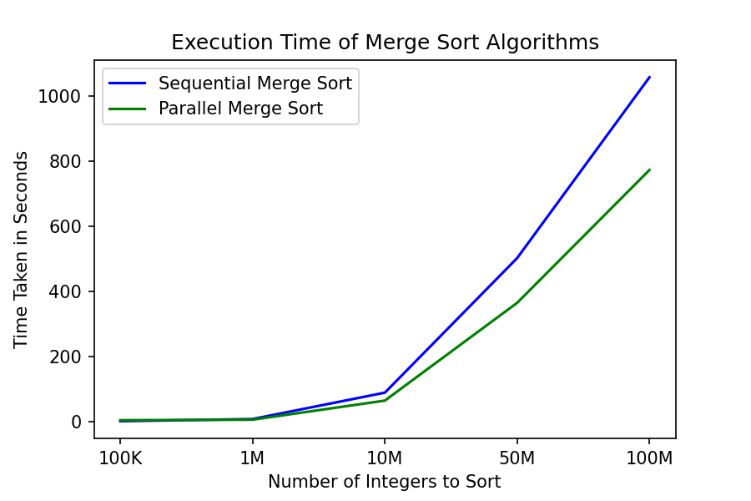
Execution Time

Slide 28
05
Performance Analysis of Quick Sort

Slide 29
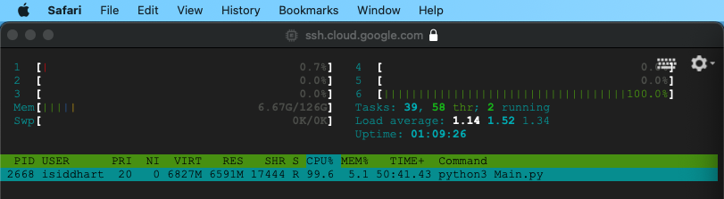
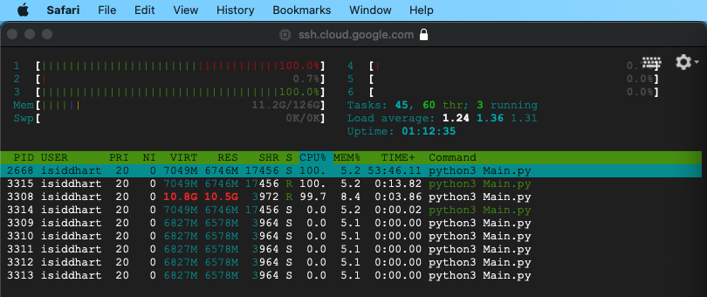
CPU and RAM Usage for Sequential Quick Sort CPU and RAM Usage for Parallel Quick Sort
Number of CPU Used : 01
Total RAM Used : 6.67 GB
Number of CPU Used : 02
Total RAM Used : 11.2 GB

Slide 30
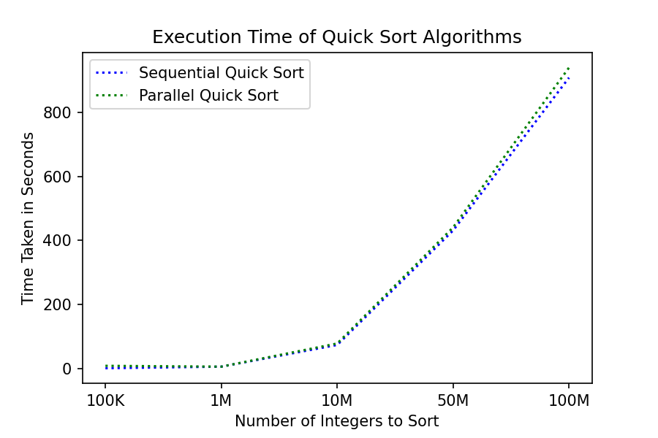
Execution Time

Slide 31
04
Summary

Slide 32
01
Performance Analysis of All Sorting Algorithms

Slide 33
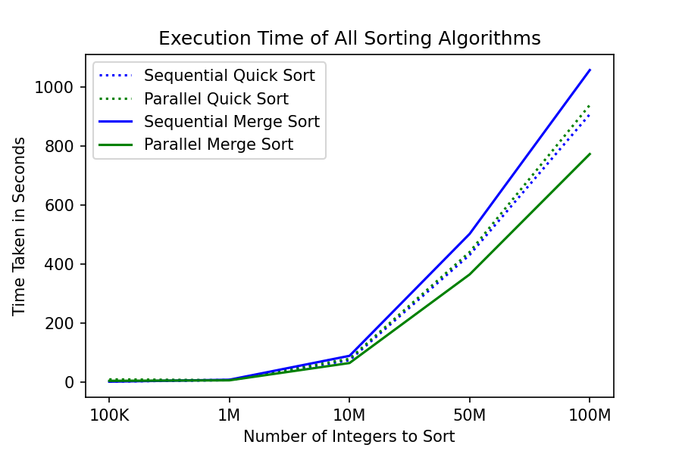
Execution Time

Slide 34
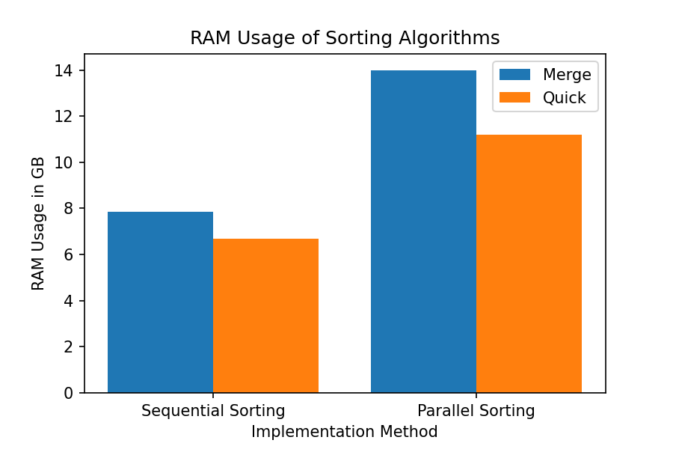
RAM Usage

Slide 35
02
Conclusion

Slide 36
Quick Sort v/s Merge Sort
Quick Sort
Merge Sort
> Performs most of the sorting in the process of dividing.
> Internal Sorting Method.
> Might Change the Relative Order of Two Equal Elements.
> Becomes Very Slow and Inefficient if chosen the wrong Pivot Element.
> Performs all the sorting during the process of merging.
> External Sorting Method.
> Maintains the Relative Order of Two Equal Elements.
> Consistent and Efficient on Any kind of Dataset.

Slide 37
Results from Comparative Study
Execution Time
RAM Usage
> Parallel Merge Sort is Faster than Parallel Quick Sort.
> Sequential Quick Sort is Faster than Sequential Merge Sort.
> Quick Sort consumes less Memory than Merge Sort.
> With Increase in Size of Dataset, Merge Sort’s Demand in Memory Increases more than that of Quick Sort.

Slide 38
05
References

Slide 39
References
https://slidesgo.com/theme/startup-inspiration-black
http://broiler.astrometry.net/~kilian/The_Art_of_Computer_Programming%20-%20Vol%201.pdf
https://www.interviewkickstart.com/learn/time-complexities-of-all-sorting-algorithms
https://en.wikipedia.org/wiki/Merge_sorthttps://academic.oup.com/comjnl/article/5/1/10/395338
https://www.baeldung.com/cs/quicksort-vs-heapsort
https://www.geeksforgeeks.org/difference-between-multiprocessing-and-multithreading/
https://docs.oracle.com/javase/tutorial/essential/concurrency/forkjoin.html
https://docs.python.org/3/library/concurrent.futures.html
https://stanford.edu/~rezab/classes/cme323/S16/notes/Lecture04/cme323_lec4.pdf
https://www.uio.no/studier/emner/matnat/ifi/INF3380/v10/undervisningsmateriale/inf3380-week12.pdf
https://link.springer.com/referenceworkentry/10.1007/978-0-387-09766-4_78

Slide 40
Thank You!

